Slide 1
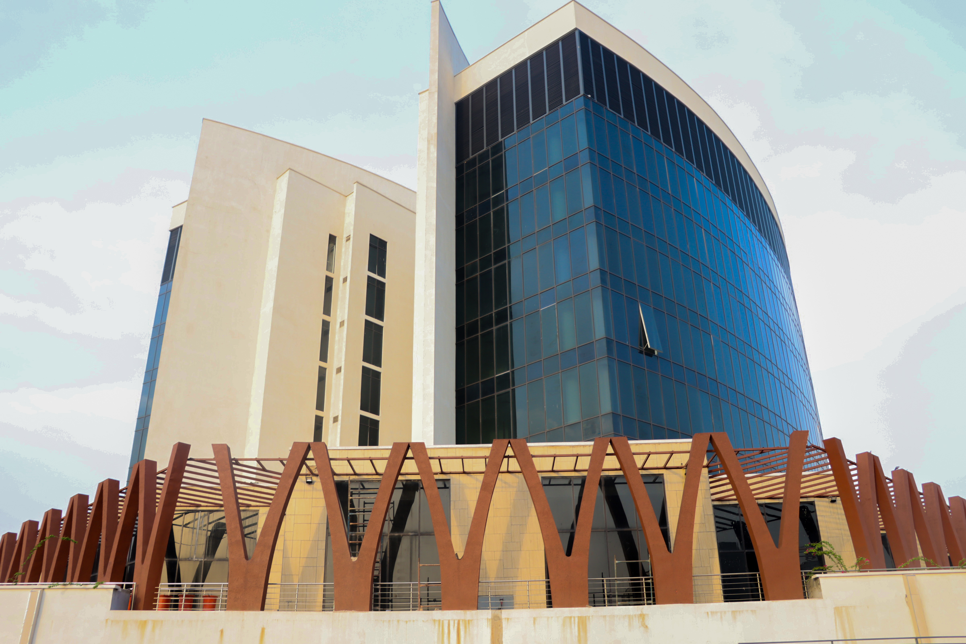
Fund Manager’s REPORT
JULY 2025

Slide 2

RSA Fund I Snapshot
Fund Summary
RSA Fund I is the most aggressive among the different RSA funds in terms of risk and potential returns, it is structured to have a higher allocation towards variable income securities, primarily equities.
This fund typically invests a significant portion of its assets in the Nigerian stock market and other high-risk, high-return instruments.
It is an optional fund that contributors must elect to opt to, with a maximum age of membership being 49 years old.
Risk Profile
It carries the highest risk among the RSA funds due to its heavy exposure to equities and variable income securities. Equities are known for their volatility and can experience significant fluctuations in value over the short term. Therefore, RSA Fund I holders are exposed to market fluctuations and may experience higher volatility in their investment returns.
Return Expectations
Due to its aggressive investment strategy, RSA Fund I has the potential to offer higher returns compared to the other RSA funds over the long term. However, these returns come with higher volatility and risk, meaning there could be periods of substantial gains but also periods of significant losses
3-Year CAGR: 24.95%
Sharpe Ratio: 0.22

Slide 3
RSA Fund II Snapshot
Fund Summary
RSA Fund II is the default RSA Fund and is a moderate-risk fund that strikes a balance between risk and potential returns.
It is structured with a mixed portfolio, investing in a combination of variable income securities (such as equities) and fixed income securities (such as bonds).
The fund's allocation typically includes a balanced mix of these asset classes, aiming to achieve moderate growth while maintaining a degree of stability.
RSA Fund II offers a middle ground for contributors who want a balanced approach to investing, seeking growth opportunities while mitigating some of the risks associated with higher exposure to equities.
Risk Profile
Fund II carries a moderate risk profile. The blend of equities and fixed income securities is designed to moderate volatility while seeking reasonable returns. The risk level is lower than Fund I due to its diversification but higher than the more conservative Fund III..
Return Expectations
RSA Fund II aims for moderate growth, offering a balance between potential returns and stability. While it may not deliver as high returns as Fund I over the long term, it seeks to provide more consistent and stable growth.
3-Year CAGR: 18.98%
Sharpe Ratio: 0.02

Slide 4
RSA Fund III Snapshot
Fund Summary
RSA Fund III focuses on a more conservative investment approach compared to Fund II. It is primarily invested in fixed income securities such as bonds, treasury bills, and other relatively low-risk, fixed-income instruments.
However, it also includes a smaller portion allocated to variable income securities like equities and designed to cater to contributors with about 10 years or less to retirement with the default age being 50 years old.
RSA Fund III offers a more conservative investment option within the multi-fund structure, catering to contributors who prioritize stability and capital preservation over higher growth potential.
Risk Profile
This fund is less exposed to market volatility and fluctuations compared to Fund I and Fund II due to its higher allocation to fixed income securities. The presence of some variable income securities introduces a modest level of risk but significantly reduces volatility compared to more aggressive funds.
Return Expectations
RSA Fund III aims to provide relatively stable and steady returns. While the potential for high returns is lower compared to the more aggressive Funds I & II, it seeks to offer a higher level of capital preservation and stability over the long term.
3-Year CAGR: 14.98%
Sharpe Ratio: -0.35

Slide 5
RSA Fund IV Snapshot
Fund Summary
The investment strategy of RSA Fund IV is centered on maintaining a conservative portfolio that emphasizes capital preservation and generating income. The fund primarily invests in low risk fixed income securities like long-term bonds and government securities to ensure stability and steady income generation.
Risk Profile
This fund is geared towards minimizing risk to safeguard retirees' savings and provide a stable income stream. It maintains a low-risk profile, reducing exposure to market volatility and aiming for consistent income rather than aggressive growth.
Return Expectations
RSA Fund IV aims to provide retirees with regular and stable income rather than high returns. The focus is on preserving the capital and ensuring that retirees have a dependable source of income during their retirement years.
3-Year CAGR: 13.94%
Sharpe Ratio: -0.69

Slide 6
RSA Fund V Snapshot
Fund Summary
Micro pension is an inclusive and flexible retirement savings plan for individuals in the informal sector. It empowers self-employed individuals and small businesses with less than 3 employees to voluntarily save and build a secure future by accumulating funds over an extended period, providing a reliable income during retirement.
Investment Strategy
The investment strategy of RSA Fund V is centered on maintaining a conservative and very liquid portfolio that emphasizes capital preservation and generating income. The fund primarily invests in low risk fixed income securities and bank deposits to ensure stability and steady income generation.
Risk Profile
This fund is geared towards minimizing risk to safeguard members savings and provide a stable income stream. It maintains a low-risk profile, reducing exposure to market volatility and aiming for consistent income rather than aggressive growth.
Return Expectations
The focus is on preserving the capital and ensuring that members have a dependable source of income during their retirement years.
3-Year CAGR: 18.12%
Sharpe Ratio: -0.03

Slide 7
RSA Fund VI Active Snapshot
Fund Summary
RSA Fund VI Active is a non-interest fund in the context of Islamic finance or Sharia-compliant investments. It typically adheres to the principles of Islamic finance.
Sharia Compliance
Non-interest funds adhere to Sharia principles, which prohibit investments in certain sectors such as gambling, alcohol, and conventional financial services that involve interest.
Risk Profile
Non-interest funds may have a moderate risk profile, focusing on stable and ethical investment opportunities that align with Sharia principles.
3-Year CAGR: 17.50%
Sharpe Ratio: -0.09

Slide 8
RSA Fund VI Retiree Snapshot
Fund Summary
RSA Fund VI Active is a non-interest fund in the context of Islamic finance or Sharia-compliant investments. It typically adheres to the principles of Islamic finance.
Sharia Compliance
Non-interest funds adhere to Sharia principles, which prohibit investments in certain sectors such as gambling, alcohol, and conventional financial services that involve interest.
Risk Profile
Non-interest funds may have a moderate risk profile, focusing on stable and ethical investment opportunities that align with Sharia principles.
3-Year CAGR: 17.35%
Sharpe Ratio: -0.14

Slide 9
Financial Market Review & Outlook
Fixed Income Review
The fixed income market remained bullish in the month of July 2025 amid sustained improvement in general macroeconomic conditions, improved liquidity conditions in the financial system, reduced supply of FGN debt securities, and a generally positive outlook for the Nigerian economy.
On average, secondary market Nigerian treasury bills yields fell by 267 bps to 17.17% while secondary market Federal Government bond yields declined by 208 bps to 16.30%.
Fixed Income Outlook
We expect a mix of bearish and bullish activities in the fixed income markets given the recent retention of the Monetary Policy Rate at 27.50% on one hand, and on the other hand, an anticipated limited supply of new issuances relative to improved liquidity conditions.

Slide 10
Financial Market Review & Outlook
Equities Market Review
Amid the declining fixed income yield environment coupled with the release of positive corporate half year results, the equities market was bullish in the month of July 2025, as the Nigerian Exchange All Share Index rose by 16.57% having recorded 99 gainers as against 19 losers.
Among the top gainers were shares of conglomerate, UACN (+115.89%), textbook publisher, Academy Press (+115.69), and cement manufacturer, Lafarge Africa (+70.87%).
Sector-wise, the Industrial sector gained 34.28%, featuring shares of Lafarge Africa, the Banking sector rose by 25.78%, led by shares of Zenith Bank (+34.33%), while the Insurance sector gained 17.74%, led by shares of Mutual Benefit Assurance (+65.45%).
Equities Market Outlook
We expect a positive outlook for equities against the backdrop of expansion in real sector activities and stability in the foreign exchange markets.

Slide 11
Important Disclosures
Disclosure Keys
The analyst holds personal positions (directly or indirectly) in one or more of the stocks covered in this report
The analyst(s) responsible for this report (whose name(s) appear(s) on the front page of this report is a Board member, Officer or Director of the Company or has influence on the company’s operating decision directly or through proxy arrangements
TRUSTFUND beneficially own 1% or more of the equity securities of the Company
TRUSTFUND holds a major interest in the debt of the Company
TRUSTFUND has received compensation for investment banking activities from the Company within the last 12 months
TRUSTFUND intends to seek, or anticipates compensation for investment banking services from the Company in the next 6 months
The content of this research report has been communicated with the Company, following which this research report has been materially amended before its distribution
The Company is a client of TRUSTFUND
The Company owns more than 5% of the issued share capital of TRUSTFUND
Conflict of Interest: It is the policy of Trustfund Pensions Ltd (thereafter collectively referred to as “TRUSTFUND”) that research analysts may not be involved in activities that suggest that they are representing the interests of TRUSTFUND in a way likely to appear to be inconsistent with providing independent investment research. In addition, research analysts’ reporting lines are structured so as to avoid any conflict of interests and biased opinions. Precisely, research analysts are fairly independent of anyone in TRUSTFUND’s Investment and Business Development departments. However, The Investment department may trade, as principal, on the basis of the research analyst’s published research. Therefore, the proprietary interests of such Business Development and Investment departments may conflict with your interests as clients. Overall, the Group protects clients from probable conflicts of interest that may arise in the course of its business relationships.
Analyst Certification
The research analysts who prepared this report certify as follows:
That all of the views expressed in this report articulate the research analyst(s) independent views/opinions regarding the companies, securities, industries or markets discussed in this report.
That the research analyst(s) compensation or remuneration is in no way connected (either directly or indirectly) to the specific recommendations, estimates or opinions expressed in this report.
Other Disclosures
Trustfund Pensions Ltd or any of its affiliates (thereafter collectively referred to as “TRUSTFUND”) may have financial or beneficial interest in securities or related investments discussed in this report, potentially giving rise to a conflict of interest which could affect the objectivity of this report. Material interests which TRUSTFUND may have in companies or securities discussed in this report are disclosed:
TRUSTFUND may own shares of the company/subject covered in this research report.
TRUSTFUND does or may seek to do business with the company/subject of this research report
TRUSTFUND may be or may seek to grant credit to the company which is the subject of this research report
TRUSTFUND or any of its officers may be or may seek to be a director in the company(ies) covered in this research report
TRUSTFUND may be likely recipient of financial or other material benefits from the company/subject of this research report.
Disclaimer
Trustfund Pensions Ltd Research notes are prepared with due care and diligence based on publicly available information as well as analysts’ knowledge and opinion on the companies, instruments and markets covered; albeit TRUSTFUND Research neither guarantees its accuracy nor completeness as the sole investment guidance for the readership. Therefore, neither TRUSTFUND nor any of its associates and employees thereof can be held responsible for any loss suffered from the reliance on this report as it is not an offer to buy or sell securities herein discussed. Please note this report is a proprietary work of TRUSTFUND and should not be reproduced (in any form) without the prior written consent of Trustfund Pensions Ltd Management. Trustfund Pensions Ltd is registered with the National Pension Commission of Nigeria (PENCOM) as a licensed pension funds administrator in Nigeria. For enquiries, contact Trustfund Pensions Ltd, 9th Floor, Plot 820/821, Labour House, CBD Garki, Abuja. Copyright Trustfund Pensions Ltd 2014.
Company | Disclosure
Access Bank Plc | -
FirstBank of Nigeria Holdings Plc | c
Guaranty Trust Bank Plc | -
United Bank for Africa Plc | d; g; h; j
Zenith Bank Plc | -
Dangote Cement Plc | -
Nigerian Breweries Plc | -
Guinness Nigeria Plc | -
Larfarge-WAPCO Plc | -
UAC of Nigeria Plc | -

