Slide 1


MONTHLY MARKET REVIEW AND Forecast FOR DECEMBER 2024
TRUSTFUND PENSIONS LTD RESEARCH
JANUARY 2025

Slide 2


GLOBAL MARKET REVIEW
INVESTMENT RESEARCH
TRUSTFUND PENSIONS LIMITED
GLOBAL MACRO MOVERS FOR THE MONTH
In December, global equities continued to express mixed sentiments following Donald Trump’s electoral win and emerging market worries over trade tariffs..
U.S. Stock markets closed the month lower despite hitting record highs earlier in the year, driven by an AI-fuelled rally and strong corporate performance.
Eurozone shares also dipped in December due to fears of recession following a contraction in manufacturing activity indicated by a 45.2 PMI, highlighting a persistent strain in the industrial sector. To support economic recovery, the European Central Bank reduced its policy rate by 25 basis points during the month. Nonetheless, Inflation stayed low, while growth in the services sector offered a slight offset to the challenges in manufacturing
Japanese equities recorded gains influenced by events in the US and their effects on financial markets, especially the currency market. A weaker yen toward the end of 2024 improved the earnings prospects for large-cap exporters, enabling the market to close the year strongly.
The NGX ASI gained 556bps to close at 102,926.40 index points, propelled by bullish sentiments in SEPLAT (+38.92%), WAPCO (+89.50%), ARADEL (+20.78%) TRANSPOWER (+19.29%) and BUAFOODS (+5.09%
*NGX – Nigerian Stock Exchange Mainboard Index
*STOXX Europe 600 – Index that tracks top 600 companies across Europe
*Nikkei 225 tracks top 225 large companies across sectors in Japan
**S&P 500 tracks top 500 companies in USA
Source: Stoxx, (2024), Schroders, (2024) Trustfund Research, (2024)

Slide 3

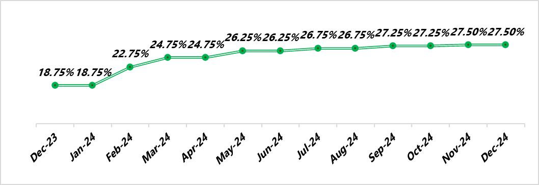

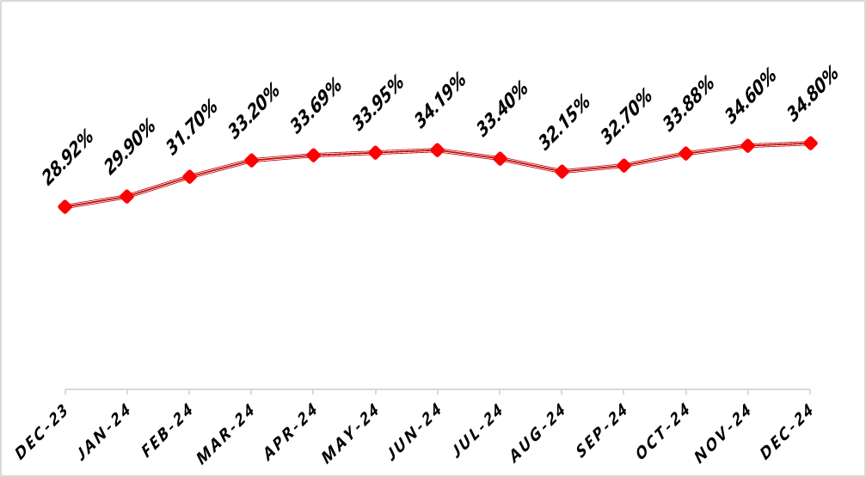

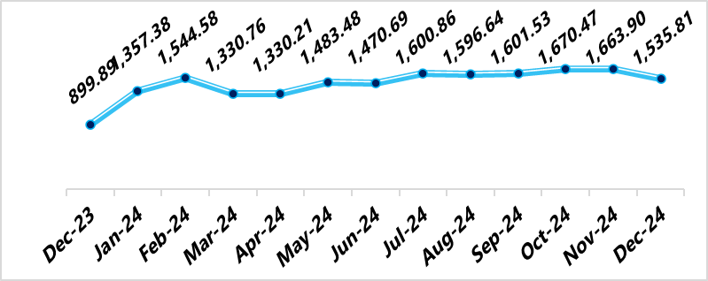

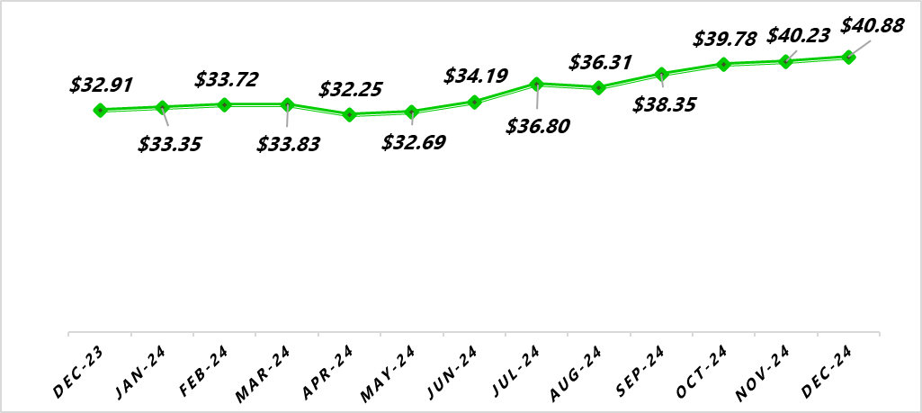
NIGERIAN MACRO REVIEW
MPR
CPI
The Monetary Policy Rate (MPR) was maintained at 27.5% in December 2024, with any potential adjustments deferred until the next Monetary Policy Committee (MPC) meeting scheduled for February 17th–18th, 2025.
Headline inflation increased by 20bps to 34.80%. This was attributed to increased pressure on transportation and energy costs during the festive season. Food and Core inflation closed at 39.84% and 29.28% respectively.
FX RATE
RESERVE
The Naira appreciated against the Dollar in the Nigerian Foreign Exchange Market (NFEM). At the close of the month, the Naira exchanged for a dollar at the rate of N1535.81 following increased diasporic inflows to the system.
In December, the External Reserve increased by 1.62% to $40.88bn from $40.23bn at the end of November 2024. This increase can be pegged to foreign capital inflows and crude oil Related Taxes.
copyright(c)Trustfund Pensions Limited

Slide 4

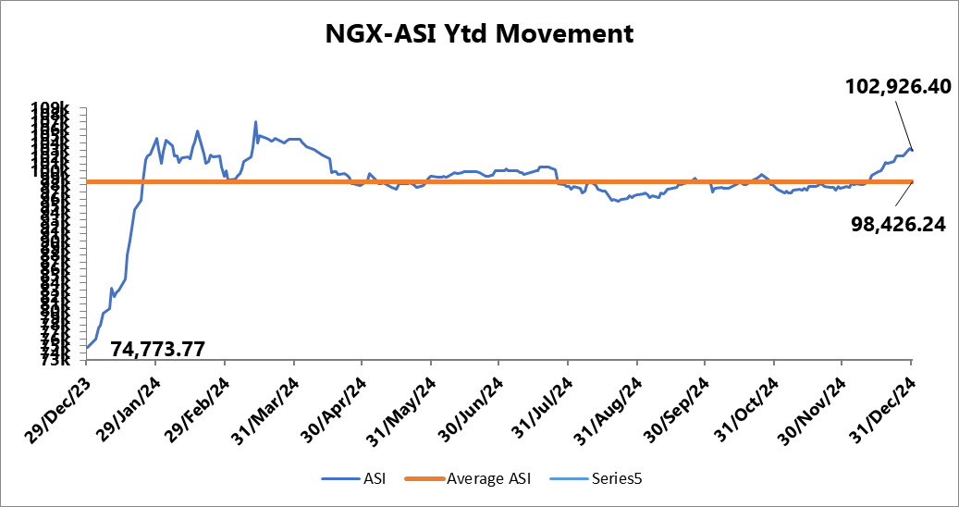
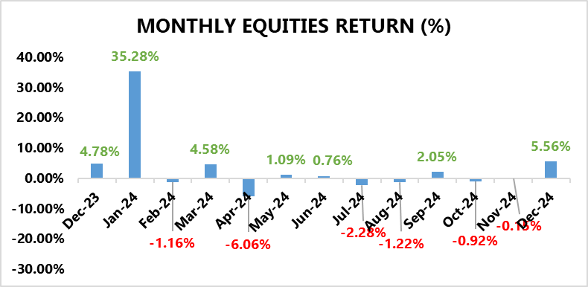
EQUITY MARKET
INVESTMENT RESEARCH
TRUSTFUND PENSIONS LIMITED
Bulls Emerge Victorious in the December Smackdown
In December, the NGX ASI soared by 556bps to close at 102,926.4 index points, propelled by bullish sentiments in SEPLAT (+38.92%), WAPCO (+89.50%), ARADEL (+20.78%) TRANSPOWER (+19.29%) and BUAFOODS (+5.09%).
In addition, there were major novel listings including Aradel Holdings Plc (N3.05 trillion), Transcorp Power Plc (N1.8 trillion) and Haldane McCall Plc (N11.99 billion), which also contributed to the market’s positive momentum.
A cursory sectoral overview revealed that all the indices under our purview closed in positive terrain.
The insurance sector topped the gainers’ chart with a 47.2% gain driven by gains in AIICO (+23.28%), MANSARD (+49.09%), NEM (+31.93%) and CORNEST (+43.43%) amongst others.
Next was the Oil & Gas index with a 13.9% gain from positive runs on SEPLAT (+39.92%), CONOIL (+130.48%) and MRS (63.13%).
Following this was the consumer goods sector recording an 8.9% increase due to gains on BUAFOODS (+5.09%) and NB (+9.59%)(+130.48%) and MRS (63.13%).
Furthermore, Banking sector closed with a 6.0% gain driven by positive sentiments on ZENITHBANK (+20.53%), GTCO (+18.75%), ACCESS (+15.78%), and UBA (+20.14%).
Lastly, the Industrial Goods sector also recorded growth, inching 1.3% higher, despite losses on DANGCEM (-10.00%) and BUACEMENT (-15.45%).
Source: Bloomberg/ TFP Research

Slide 5
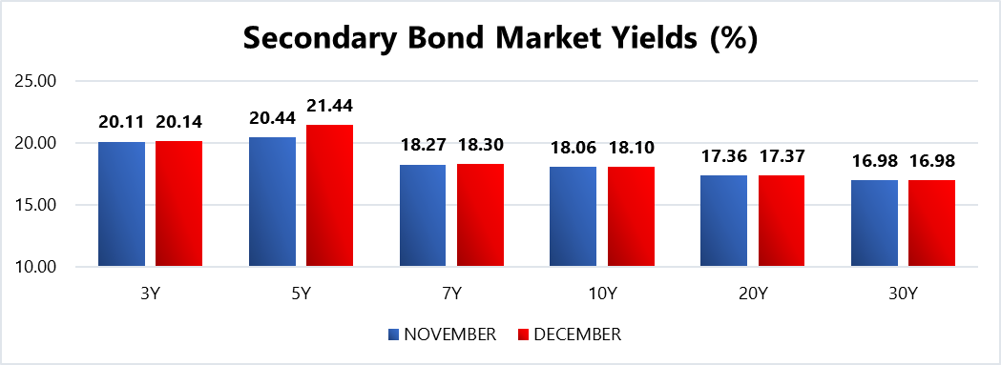
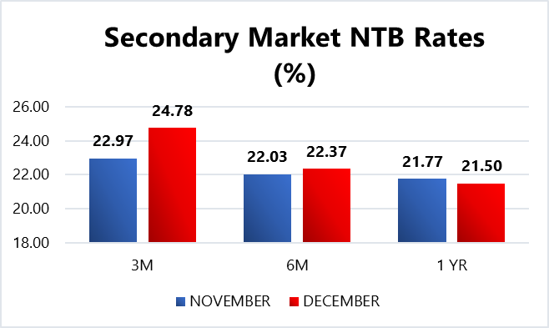
FIXED INCOME MARKET
INVESTMENT RESEARCH
TRUSTFUND PENSIONS LIMITED
Sentiments were largely bearish in December underpinned by;
The Mpc’s Hawkish Monetary Policy stance
The lingering demand and supply imbalance amidst the FGN’s budget deficit
Tight financial system liquidity
Efforts to attract FPIs by repricing instruments and reduce negative real return.
Subsequently, average bond yields gained 29 bps MoM to close at 19.75%, whilst average discounted rate on NTBs gained 40bps to close at 22.89% MoM.
In other news, the DMO held an FGN bond auction during the month where up to N120.00bn worth of the 18.50% FGN FEB 2031, and 19.30% FGN APR 2029 instruments were offered to auction participants (same as last month’s instruments on offer). Eventually, the FGN sold approximately N211.14bn worth of these instruments to investors at respective stop rates of 22.00% (Unchanged) and 21.14% (prev. 21.00%). Notably, the auction was 2.32x oversubscribed.
Additionally, there were two NTB auctions held in November where a total of N608.24bn worth of the 91 DTM, 182 DTM and 364 DTM bills were rolled over and offered to investors. Eventually, N860.37bn worth of these bills were sold at respective average stop rates of 18.00% (unchanged), 18.50% (unchanged) and 22.85% (prev. 23.25%).
Confidential. Copyright © Trustfund Pensions Ltd

Slide 6
FIXED INCOME MARKET
INVESTMENT RESEARCH
TRUSTFUND PENSIONS LIMITED
Also, subscription levels reached N1,571.03bn, indicating a bid to offer ratio of 2.58x and a bid to cover ratio of 1.83x.
In January, we expect comparatively stable market conditions with elevated yields. Nonetheless, these are barring any radical global macroeconomic shifts/apex bank interventions/ liquidity shocks to the system.
Confidential. Copyright © Trustfund Pensions Ltd

Slide 7
MARKET OUTLOOK AND STRATEGY
INVESTMENT RESEARCH
TRUSTFUND PENSIONS LIMITED
In December 2024, Nigeria faced persistent inflation due to high food and energy costs, with the Central Bank maintaining tight monetary policies to stabilize prices. Economic growth projections for 2025 indicate a modest expansion of around 3.2%, supported by fiscal reforms aimed at boosting trade, investment, and human capital. Challenges in the investment climate persisted despite government efforts to attract foreign direct investment. The Senate proposed criminalizing large-scale unprocessed corn exports to address food security concerns. For January 2025, the focus remains on inflation control, structural reforms, and improving the investment climate to foster sustainable economic growth and stability.
EQUITY
FIXED INCOME
Bond – We expect yields to remain elevated as the CBN aims to attract foreign investors by offering competitive returns. Thus, will continue to take advantage when suitable opportunities are identified.
Corporate Issuances – our focus will be on available ”A” rated corporate bonds at attractive yields to further boost portfolio return.
Treasury Bills – we expect yields to remain at double digit levels.As such, we will continue to monitor its trend and take position in yields not less than rates obtainable in money market.
Money Market – We expect an increase in rates due to tight system liquidity. As such, we will be strategic with our positions on the short end of the curve to maximize the most attractive rates and support our liquidity laddering strategy, whilst ensuring safety of funds.
We expect sustained positive sentiments from investors amid the anticipated earnings performance of blue-chip stocks during earnings season. Nonetheless, these expectations are barring any radical global macroeconomic shifts/ apex bank interventions/ liquidity shocks to the system.
7
We will continue to take advantage of market opportunities with focus on corporate issuances and alternative assets to improve investment returns. As such, asset exposure may vary over time.
copyright(c)Trustfund Pensions Limited

